Slide 1
Project Title:
Univ. Library Visitors
Student’s Name: __R.RAJENDRA KUMAR
Course : CS694AH1 TOPIC: BIG DATA SYSTEMS, Semester:__3rd_________
Professor’s Name: Prof. Dr. Bhumip KHASNABISH
Presentation Date, Location & Time: ………………………

Slide 2
Outline
Abstract and Summary
Main Focus of the Project
Survey of Previous works
Distinction of the Current Work
Usefulness of the Current Work
Simulation/Emulation Details
Results
Future works
Q&A and Discussion
References
Background and Other Information

Slide 3
Abstract and Summary
In this project perform the analysis on university library visitors.
This project will provide the information about offline library visitors and online university library website visitors like visitors and sessions reports.

Slide 4
Main Focus of the Project
The main focus of project is statistical analysis of university library visitors.
In this project perform the analysis based on Monthly visitors of library, how visitors are using the library resources like rooms, materials and Systems .
Perform statistics on visitors of library and room reservation details and finally provide online library website page visitors details also.

Slide 5
Survey of 5 Previous Similar Works (over last 3 years or so)
The 2016 survey shows that, within the context of evolving library usage patterns, public attitudes are largely positive about the library’s role in communities. Many Americans are interested in libraries offering a range of services – including those that help people improve their digital skills and learn how to determine what information is trustworthy.
Library cuts reflected in 30% drop in adult visitors over a decade. This article is more than 3 years old. Campaigners say fall in adult visitors over 10 years shows ‘it’s time to stop talking about the dismantling of library services and instead to demand action’.
In 2019 Article mentions that Americans go to public libraries more often than they go to the movies.
http://www.ala.org/advocacy/sites/ala.org.advocacy/files/content/Quotable%20Facts..Jan.19.FINAL.ANNOTATED.pdf

Slide 6
Distinction of the Current Work
In this project main distraction work is statistical analysis of library visitors information.
In this project using advanced python generate the visualization graphs regarding library visitors.
The generated graphs are easy and understandable type.

Slide 7
Usefulness of the Current Work
The main benefits of this current project is university library management administration easy to monitor the library visitors information.
Based on library visitors the library management department easy to know about the strengths and improvements of university library management system.

Slide 8
Simulation/Emulation Details (Environment and Setup)
Installed python latest version and installed anaconda jupytor notebook.
Setup the jupytor notebook.
Develop and execute the code in jupytor notebook and generate the output graphs.

Slide 9
Simulation/Emulation Details (Tools and Monitoring Options)
The library visitors information is analyzed and monitored based on list of types.
Monthly library visitors
Visitor page views and session details
Resources wise visitors
Visitors room reservation information

Slide 10
Simulation/Emulation Details [Adjustment(s), Adaptations, etc.]
Actually in this project created the datasets for analysis of library visitors in 2019 year.
Prepare the input data of 12 months in 2019 year.
If any adjustments or updates performed in datasets and get the updated results.

Slide 11
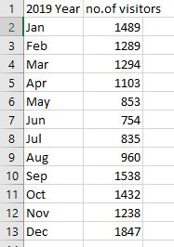
Results
Monthly visitors input dataset

Slide 12
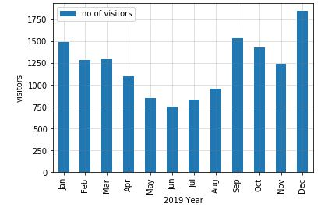
Results
Monthly visitors output

Slide 13
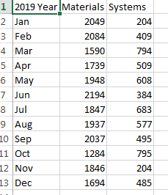
Results
Visitors Resources dataset

Slide 14
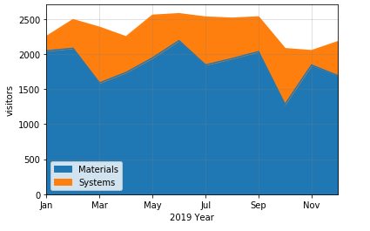
Results
Visitors Resources Output

Slide 15
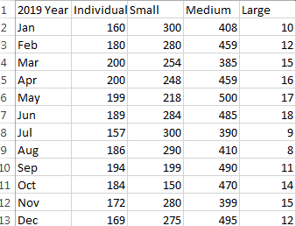
Results
Visitors Room reservation dataset

Slide 16
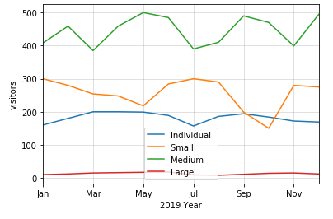
Results
Visitors Room reservation

Slide 17
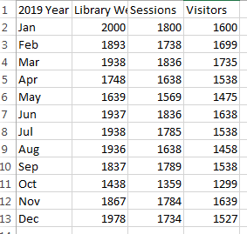
Results
Online Library Visitors page views dataset

Slide 18
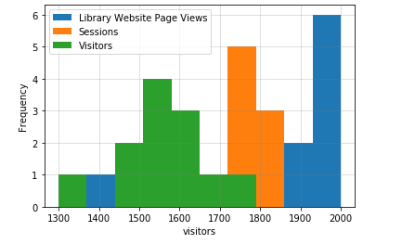
Results
Online Library Visitors page views

Slide 19
Future Works
The future work of this project is provide library visitors information of past, present and future years and compare the results.
The prediction and forecast of library visitors is another future work.

Slide 20





Q&A and Discussion
Thanks for Your KIND Attention
Discussion

Slide 21
References
https://www.tutorialspoint.com/python/index.htm
https://www.learnpython.org/

Slide 22
Background and Other Information

Slide 23
Weekly Activities Log
Week No. | List of Tasks (Planned) | Log of Achievements, Errors, and Learning
02 | Reading three books Selecting the project Assignment 1 | Submitted the summary for the three books. Decided my project.
03 | Doing the required research for my project. Collecting the data on the visitors of our library. Reading the given book for the class discussion. | Completed all the tasks planned.

Slide 24
Weekly Activities Log
Week No. | List of Tasks (Planned) | Log of Achievements, Errors, and Learning
04 | Reading the books and preparing 3 questions for the discussion. Collecting the data from the library. | I have prepared the 3 questions for the discussion. I couldn’t get data from the college.
05 | After analysis prepare the dataset for developed project. Based on my data collection prepared the 4 types of dataset for Analysis of library visitors | All achieved.

Slide 25
Weekly Activities Log
Week No. | List of Tasks (Planned) | Log of Achievements, Errors, and Learning
06 | Develop the code for analysis of library visitors based on term | All finished.
07 | Develop the code for analysis of library visitors based on utilization of resources | All finished.

Slide 26
Weekly Activities Log
Week No. | List of Tasks (Planned) | Log of Achievements, Errors, and Learning
08 | Develop the code for analysis of library visitors based on room reservation. Develop the code for analysis of library visitors based on online user sessions and page views.

